Slide 1
Is The New Testament A PATTERN?
That You May Know The New Testament Is Our Pattern Today
(part 3)

Slide 2
Previously:
A pattern has existed in every time period (Patriarchal and Mosaic)
Six reasons why the New Testament is our pattern

Slide 3
5 Things That Must Be True For A Pattern To Exist

Slide 4
For A Pattern To Exist:
It must have been conceived
Its enactment must be accepted by the author
It must have been revealed
Preserved, recorded, delivered
It must call for certain behavior or action to be reproduced
In rejecting it, there is a rejection of the author and his way

Slide 5
For A Pattern To Exist:
It must have been conceived
“Known to God from eternity are all His works” (Acts 15:18)
Who will contend that the New Testament was not known to God from eternity (Is. 46:10-13; Jer. 31:31-34; Eph. 1:11; 3:10, 11)?
“To them God willed to make known what are the riches of the glory of this mystery among the Gentiles: which is Christ in you, the hope of glory” (Col. 1:27)

Slide 6
For A Pattern To Exist:
It must have been conceived
Its enactment must be accepted by the author
37 "All that the Father gives Me will come to Me, and the one who comes to Me I will by no means cast out.
38 "For I have come down from heaven, not to do My own will, but the will of Him who sent Me.
39 "This is the will of the Father who sent Me, that of all He has given Me I should lose nothing, but should raise it up at the last day. (Jn. 6)

Slide 7
For A Pattern To Exist:
It must have been conceived
Its enactment must be accepted by the author
28 Then Jesus said to them, "When you lift up the Son of Man, then you will know that I am He, and that I do nothing of Myself; but as My Father taught Me, I speak these things.
29 "And He who sent Me is with Me. The Father has not left Me alone, for I always do those things that please Him” (Jn. 8:28, 29)
See also:

Slide 8
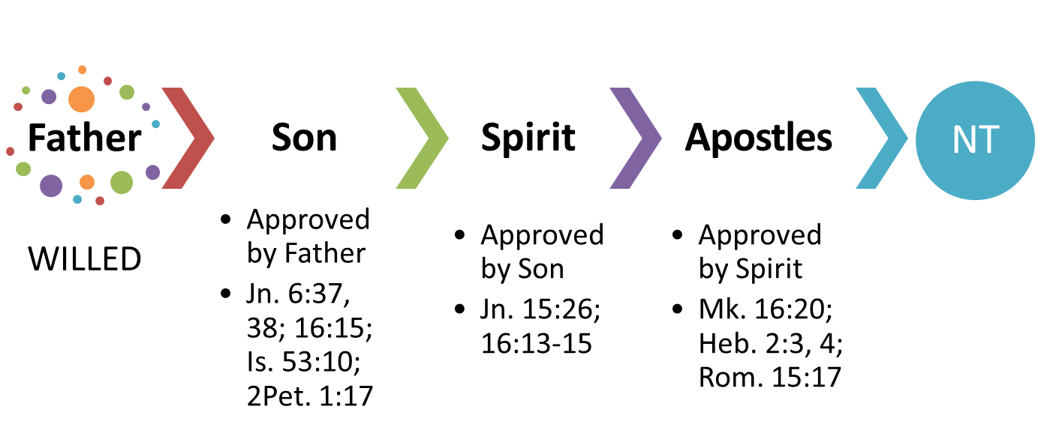
New Testament Approved!

Slide 9
For A Pattern To Exist:
It must have been conceived
It must be approved of by the originator
It must have been revealed
Preserved, recorded, delivered
“The secret things belong to the LORD our God, but those things which are revealed belong to us and to our children forever, that we may do all the words of this law” (Deut. 29:29)
Acts 7:44
“But before faith came, we were kept under guard by the law, kept for the faith which would afterward be revealed” (Gal. 3:23)
Ephesians 3:1-6

Slide 10
For A Pattern To Exist:
It must have been conceived
It must be approved of by the originator
It must have been revealed
Preserved, recorded, delivered
It must call for certain behavior or action to be reproduced
“If anyone thinks himself to be a prophet or spiritual, let him acknowledge that the things which I write to you are the commandments of the Lord” (1 Cor. 14:37)
Luke 6:46-49

Slide 11
For A Pattern To Exist:
It must have been conceived
It must be approved of by the originator
It must have been revealed
Preserved, recorded, delivered
It must call for certain behavior or action to be reproduced
Rejecting the pattern is rejecting the author of it
Luke 10:16, “He who hears you hears Me, he who rejects you rejects Me, and he who rejects Me rejects Him who sent Me.”
1 Thess. 4:1-8

Slide 12
Have You Followed The Pattern?
TO BE SAVED
Believe
Repent
Confess
Baptized
Mk. 2:1-5; 5:25-34; etc.
Mk. 1:14, 15, 2:17; 6:7-12
Mk. 10:17, 18; 11:27-33
Mk. 16:15, 16

